Slide 1
PUBLIC HUMAN ASSAULT PREDICTION USING HUMAN ACTIVITY RECOGNTION WITH AI

Slide 2
CONTENTS
Problem Statement
Abstract
Objective
Motivation
Existing and Proposed System
Literature Review
Proposed System Architecture
Modules Description
Hardware Requirements
Software Requirements
Application
References

Slide 3
PROBLEM STATEMENT
Inefficient Human activity recognition model.
Costlier solutions for Human activity recognition due to the use of 3D cameras.
Difficulty in deploying real time Human activity recognition application due to costlier models.

Slide 4
OBJECTIVE
To develop a highly accurate Human Activity recognition model.
To develop a efficient model for real time deployment.
To make this model as a surveillance solution for road surveillance
To develop a mobile application for providing alert to the police in case of theft detection by detecting the human activities.
To accomplish Live streaming through mobile application.

Slide 5
ABSTRACT
Recognizing human activities from video sequences or still images is a challenging task due to problems, such as background clutter, partial occlusion, changes in scale, viewpoint, lighting, and appearance.
Human activity recognition, or HAR, is a challenging time series classification task. It involves predicting the movement of a person based on sensor data and traditionally involves deep domain expertise and methods from signal processing to correctly engineer features from the raw data in order to fit a machine learning model.
Human Activity Recognition plays a significant role in human-to-human and human-computer interaction.
So this system will not only be cost effective but also as a utility-based system that can be incorporated in a large number of applications that will save time and aid in various activities that require recognition process, and save a lot of time with good accuracy.

Slide 6
EXISTING SYSTEM
In the existing system, it proposes a dual stacked autoencoders features embedded clustering (DSAFEC) and a BOW construction method based on the DSAFEC (B-DSAFEC) to reduce the computational complexity and to remove the selection restriction.
The DSAFEC first transforms feature points extracted from a video to a learned feature space and then probabilities of cluster assignment of feature points are predicted to build BOWs for human activity recognition.
A soft clustering is used by assigning each feature point to multiple clusters yielding the largest probabilities instead of only one in hard clustering.

Slide 7
DISADVANTAGES OF EXISTING SYSTEM
The system uses dual stacked auto encoders which for video dataset is insufficient to extract the data.
Although the training is faster in radial basis function neural network (RBFNN) network but classification is slow in comparison due to nodes in hidden layer have to compute the RBF function for the input sample vector during classification.
The system does not provide an effective technological solution for real time deployment.

Slide 8
LITERATURE REVIEW
TITLE OF THE PAPER | AUTHOR NAME | ALGORITHM | ADVANTAGE | DISADVANTAGE
A Deep Clustering via Automatic Feature Embedded Learning for Human Activity Recognition[2021] | Ting Wang, Wing W. Y. Ng*, Jinde Li, Qiuxia Wu, Shuai Zhang, Chris Nugent, Colin Shewell, | dual stacked autoencoders features embedded clustering (DSAFEC) | Used to identify the range of human pose motion. | The system uses dual stacked auto encoders which for video dataset is insufficient to extract the data.
Presentation Attack Detection for Face Recognition using Light Field Camera | R. Raghavendra Kiran B. Raja Christoph Busch Norwegian Biometric Laboratory, Gjøvik University College, Norway | Face Presentation Attack Detection (PAD) | The light field face artefact database have revealed the outstanding performance of the proposed PAD scheme when benchmarked with various well established state-of-the-art schemes. | There exists no superior PAD technique due to evolution of sophisticated presentation attacks

Slide 9
LITERATURE REVIEW
TITLE OF THE PAPER | AUTHOR NAME | ALGORITHM | ADVANTAGE | DISADVANTAGE
“PrivHome: Privacy-Preserving Authenticated Communication in Smart Home Environment [2019, VOL. 99, NO. 99] | Geong Sen Poh, Prosanta Gope, Member, IEEE , and Jianting Ning | lightweight entity and key-exchange protocol, and an efﬁcient searchable encryption protocol | A smart home enables users to access devices such as lighting, HVAC, temperature sensors, and surveillance camera. It provides a more convenient and safe living environment for users | Less accuracy.
“Continuous Human Motion Recognition With a Dynamic Range-Doppler Trajectory Method Based on FMCW Radar “ [2019, VOL. 57, NO. 9, ] | Chuanwei Ding , Student Member, IEEE, Hong Hong , Member, IEEE, Yu Zou, Student Member, IEEE, Hui Chu , Xiaohua Zhu, Member, IEEE, Francesco Fioranelli , Member, IEEE, Julien Le Kernec , Senior Member, IEEE, and Changzhi Li , Senior Member, IEEE | range-Doppler trajectory (DRDT) method based on the frequency-modulated continuous-wave (FMCW) | the DRDT is extracted from these frames to monitor human motions in time, range, and Doppler domains in real time. | Less accuracy.

Slide 10
LITERATURE REVIEW
TITLE OF THE PAPER | AUTHOR NAME | ALGORITHM | ADVANTAGE | DISADVANTAGE
“PRNU-Based Camera Attribution from Multiple Seam-Carved Images ” [2017, VOL. 20, NO. 5, ] | BSamet Taspinar, Manoranjan Mohanty, and Nasir Memon | PRNU Noise Pattern, Countering SeamCarving-Based Anonymization, Source Camera Attribution. | seamcarved images from the same camera, source attribution can still be possible even if the size of uncarved blocks in the image is less than the recommended size of 50×50 pixels. | Less real time process.
“An Integrated Cloud-Based Smart Home Management System with Community Hierarchy ”, [2016, Vol No: 2162-237X] | Ying-Tsung Lee, Wei-Hsuan Hsiao, Chin-Meng Huang and Seng-Cho T. Chou | Smart Home Management System, Community Broker, Cloud Services, MQTT | At the home end, a home intranet was created by integrating a fixed touch panel with a home controller system and various sensors and devices to deliver, for example, energy, scenario information, and security functions. | Costly kit

Slide 11
PROPOSED SYSTEM
In this project, KTH video dataset is used for designing the system.
Preprocessing technique is used to extract the certain frames in dataset.
In feature extraction process, Pixel and Optical flow feature extraction techniques are used to extract the features.
Data visualization method is used for visualize the feature extraction.
The deep learning algorithm such as Spatio-Temporal Net is then used to determine and classify the activities of a human.
We can provide this efficient model as an application to road surveillance as such a camera module fixed in the road to perform constant surveillance.
The camera on recognizing abnormal detection from the humans such as fights, etc., an alert notification is sent to the police.
A mobile application is developed using react native which will be held by the police to which, the camera on recognizing abnormality in the humans an alert notification is sent and live streaming is enabled.
Thus, this project successfully provides a Human activity recognition model incorporating AI to the cameras which can be used in real time applications such as a solution to prevent and provide evidence of an abnormal detection in road.

Slide 12
ADVANTAGES OF PROPOSED SYSTEM
• Highly accurate Human activity recognition system.
• Effective model development suitable for real time application deployment.
• Cheap and effective solution for real time road surveillance.
• Provides alert to the police in case of theft detection by detecting the human activities.
• Live streaming through the mobile application.

Slide 13
ARCHITECTURAL DIAGRAM

Slide 14
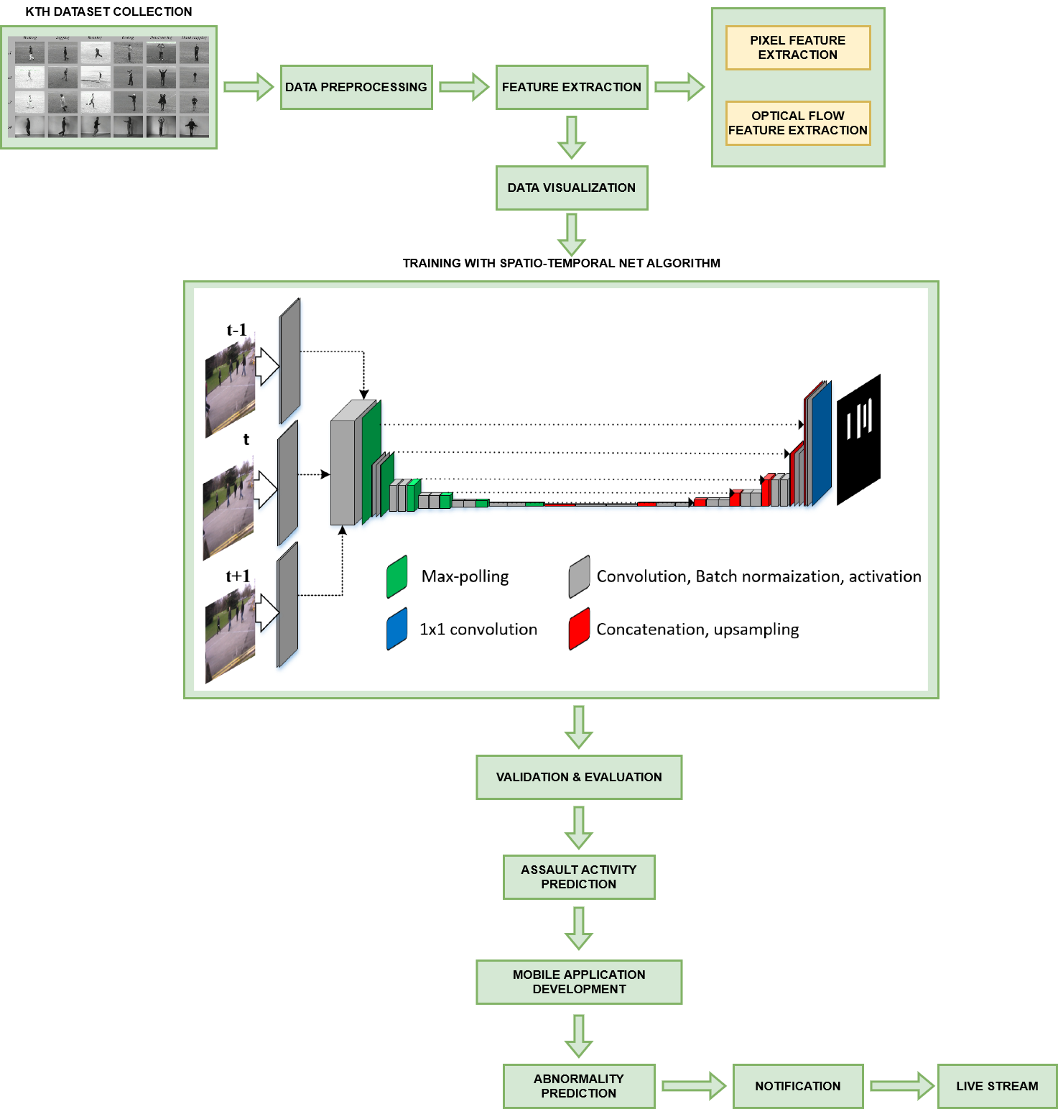

Slide 15
MODULES DESCRIPTION
Human Activity Collection
Data Preprocessing
Feature Extraction
Data Visualization
Training with the deep learning algorithm
Validation and Evaluation
Assault Activity Prediction
Mobile Application Development

Slide 16
HUMAN ACTIVITY COLLECTION MODULE
Human activity collection module is the process of collecting various activities that will be processed by the system for performing deep learning process.
The KTH video database containing six types of human actions (walking, jogging, running, boxing, hand waving and hand clapping) performed several times by 25 subjects in four different scenarios.
The database contains 2391 sequences. All sequences were taken over homogeneous backgrounds with a static camera with 25fps frame rate.
The sequences were downsampled to the spatial resolution of 160x120 pixels and have a length of four seconds in average.

Slide 17
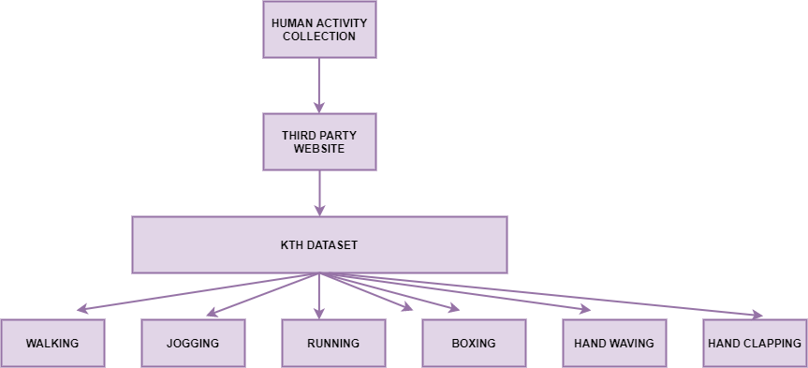
HUMAN ACTIVITY COLLECTION MODULE DFD

Slide 18
DATA-SET PREPROCESSING
Data preprocessing is a process of preparing the raw data and making it suitable for a machine learning model.
It is the first and crucial step while creating a machine learning model.
When creating a machine learning project, it is not always a case that we come across the clean and formatted data.
And while doing any operation with data, it is mandatory to clean it and put in a formatted way. So for this, we use data preprocessing task.
A real-world data generally contains noises, missing values, and maybe in an unusable format which cannot be directly used for machine learning models.

Slide 19
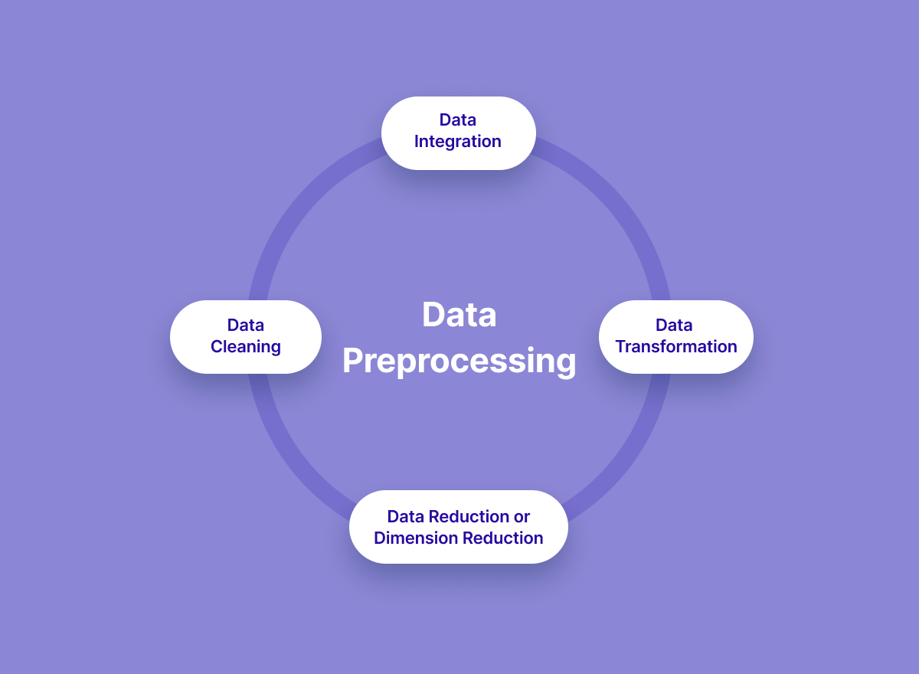
DATA-SET PREPROCESSING DFD

Slide 20
FEATURE EXTRACTION
Optical flow, or motion estimation, is a fundamental method of calculating the motion of image intensities, which may be ascribed to the motion of objects in the scene. Optical-flow methods are based on computing estimates of the motion of the image intensities over time in a video.
Spatial features capture the change in space due to the movement, whereas temporal features represent time factors during the movement. The spatiotemporal features tell us where the object is at a particular instant of time in the frame.

Slide 21
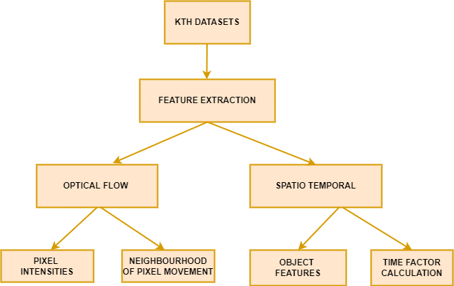
FEATURE EXTRACTION DFD

Slide 22
DATA VISUALIZATION
Data visualization is the graphical representation of information and data.
By using visual elements like charts, graphs, and maps, data visualization tools provide an accessible way to see and understand trends, outliers, and patterns in data.
Additionally, it provides an excellent way for employees or business owners to present data to non-technical audiences without confusion.
In the world of Big Data, data visualization tools and technologies are essential to analyze massive amounts of information and make data-driven decisions

Slide 23
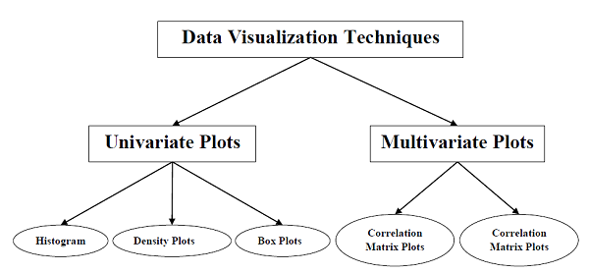
DATA VISUALIZATION DFD

Slide 24
TRAINING WITH THE DEEP LEARNING ALGORITHM
After Data Visualization, it will be fed for training with the deep learning algorithm such as Spatio-Temporal Net is used to determine and classify the activities of a human.
Spatio-temporal graphs are made of static structures and time-varying features, and such information in a graph requires a neural network that can deal with time-varying features of the graph.
Neural networks which are developed to deal with time-varying features of the graph can be considered as Spatio-temporal graph neural networks.
Spatio-temporal networks are spatial networks whose topology and parameters change with time.

Slide 25
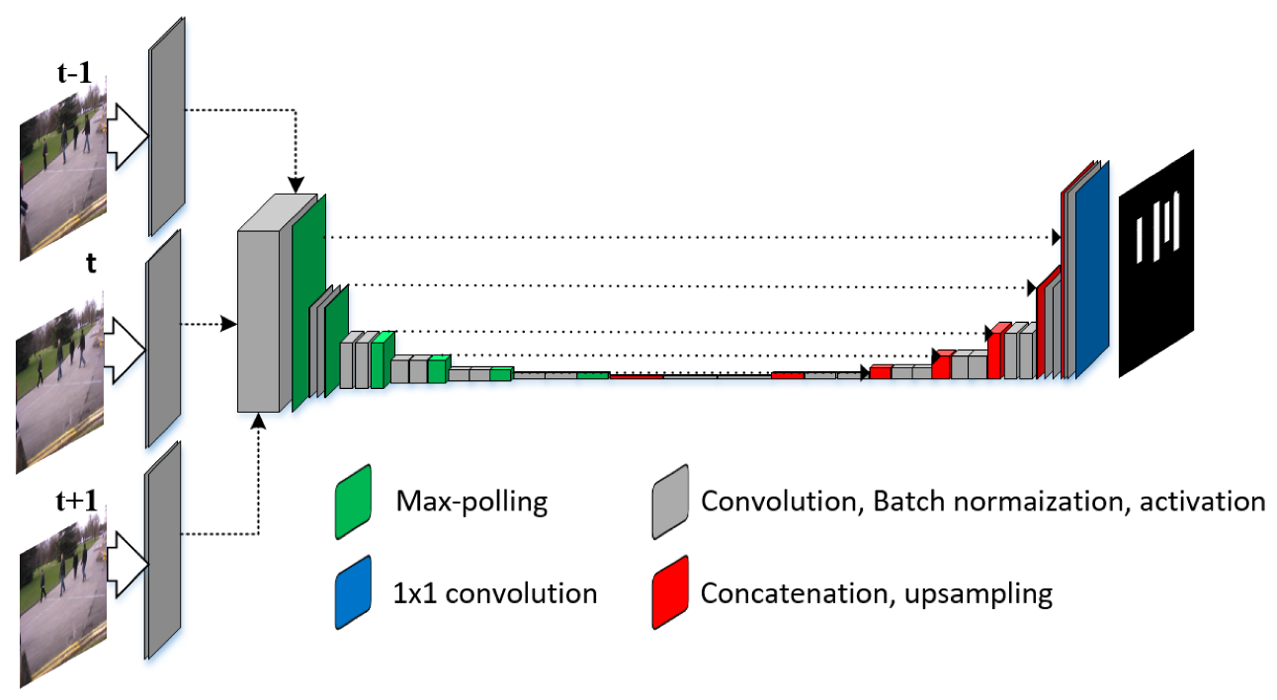
TRAINING WITH THE DEEP LEARNING ALGORITHM

Slide 26
VALIDATION AND EVALUATION
After training with Spatio-Temporal Net algorithm, it will validate and evaluate the datasets.
Validation in deep learning is like a authorization or authentication of the prediction done by a trained model.
While on the other hand, evaluation in deep learning refers to assessment or test of entire deep learning model and its performance in various circumstances.
It involves assessment of deep learning model training process, deep learning algorithms performance and how accurate is the predictions given in different situations.

Slide 27
ASSAULT ACTIVITY PREDICTION
The main purpose of this research work is to find the best prediction model i.e., the best Deep Learning techniques which will determine and classify the activities of a human.
We can provide this efficient model as an application to road surveillance as such a camera module fixed in the road to perform constant surveillance.
The camera on recognizing abnormal detection from the humans such as fights, etc., an alert notification is sent to the police.
A mobile application is developed using react native which will be held by the police to which, the camera on recognizing abnormality in the humans an alert notification is sent and live streaming is enabled.
Thus, this project successfully provides a Human activity recognition model incorporating AI to the cameras which can be used in real time applications such as a solution to prevent and provide evidence of an abnormal detection in road.

Slide 28
MOBILE APPLICATION DEVELOPMENT
React Native is a framework that builds a hierarchy of UI components to build the JavaScript code.
It has a set of components for both iOS and Android platforms to build a mobile application with a native look and feel.
React Native seems to be a viable solution for building high-quality apps in a short time with the same performance and user-experience standards that native apps provide.
React Native uses different mechanisms to create an efficient, consistent and reusable visual identity for the applications.

Slide 29
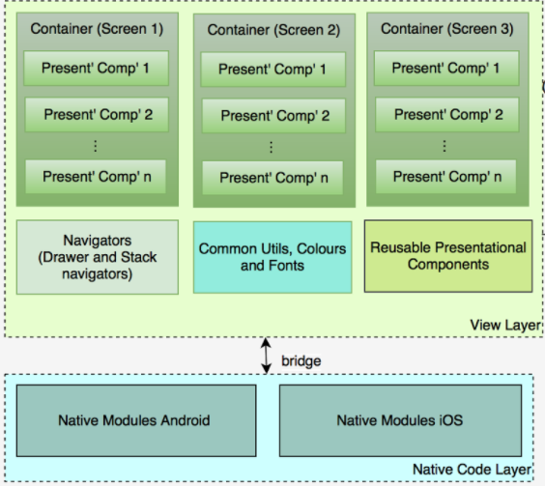
MOBILE APPLICATION DEVELOPMENT DFD

Slide 30
HARDWARE REQUIREMENTS
PC
RAM : 8 GB
Processor : i5
Hard disk : 1 TB
Camera

Slide 31
SOFTWARE REQUIREMENTS
VISUAL STUDIO
PYTHON

Slide 32
APPLICATIONS
Roads
Banks
Homes
Commercial spaces

Slide 33
OUTPUTS OBTAINED

Slide 34
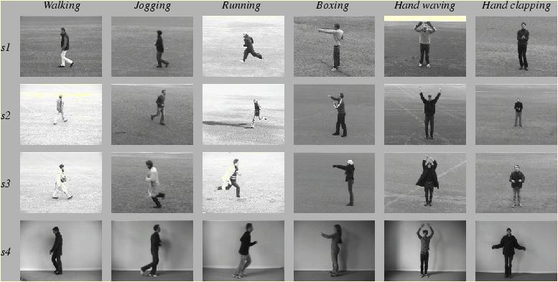
DATASET COLLECTION

Slide 35
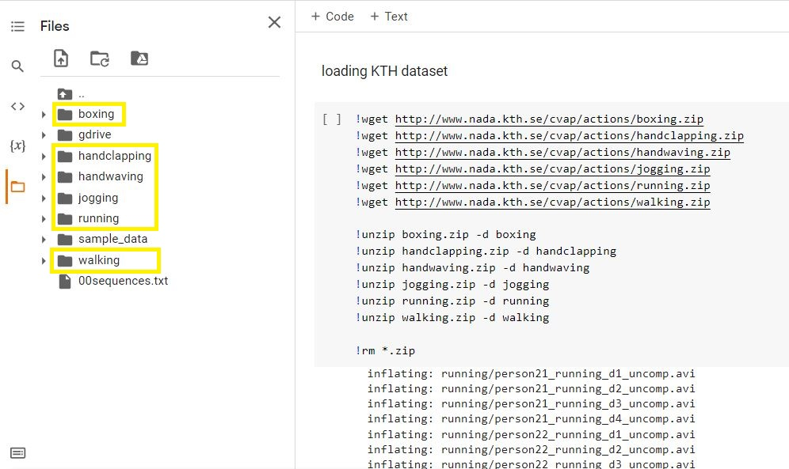
LOADING DATASET

Slide 36
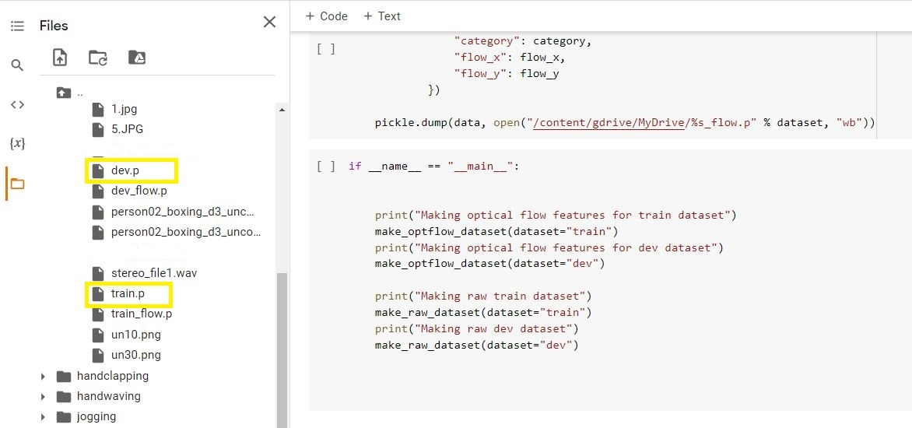
MAKING RAW DATASET FOR TRAIN AND VALIDATION

Slide 37
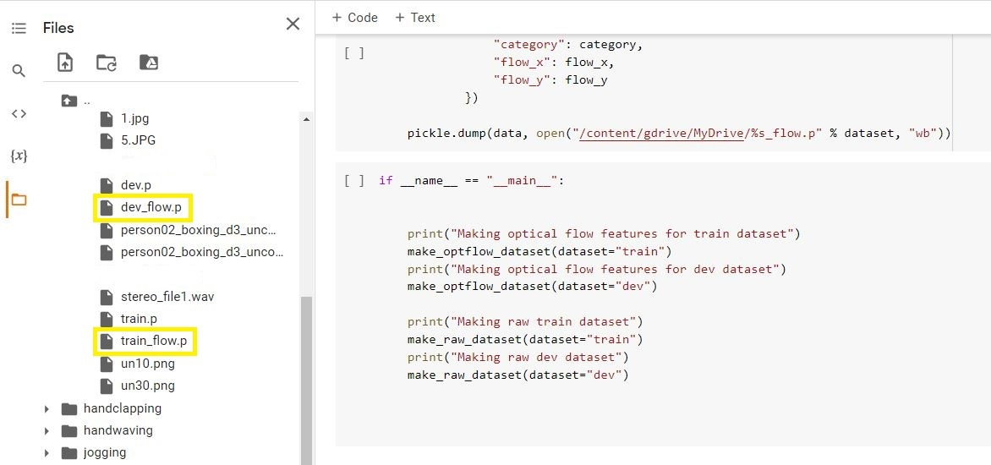
MAKING OPTICAL FLOW DATASET FOR TRAIN AND VALIDATION

Slide 38
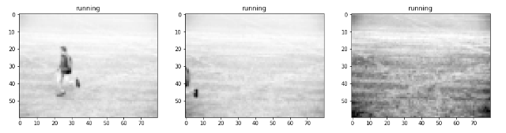
PIXEL FEATURE EXTRACTION

Slide 39
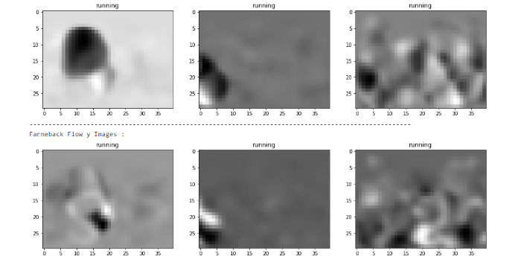
OPTICAL FLOW FEATURE EXTRACTION

Slide 40
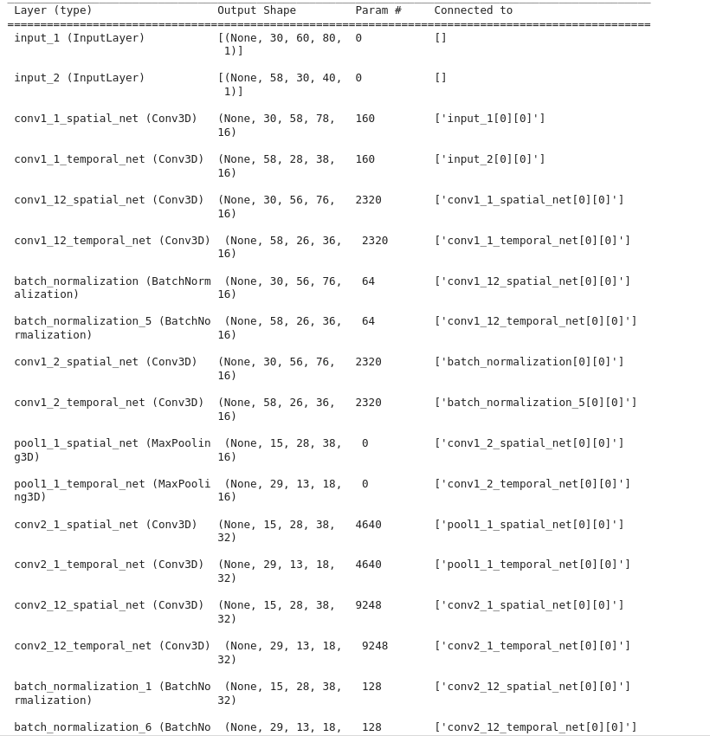
SUMMARY OF SPATIO TEMPORAL NET ALGORITHM

Slide 41
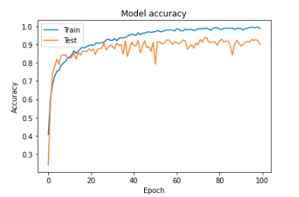
TRAINING AND VALIDATION ACCURACY OF SPATIO TEMPORAL NET ALGORITHM

Slide 42
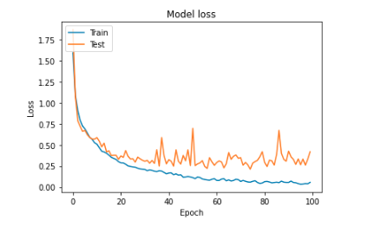
TRAINING AND VALIDATION LOSS OF SPATIO TEMPORAL NET ALGORITHM

Slide 43
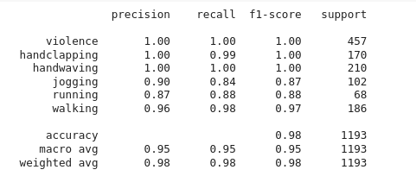
CLASSIFICATION REPORT

Slide 44
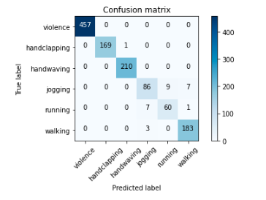
CONFUSION MATRIX

Slide 45

MOBILE APP LOGIN PAGE

Slide 46
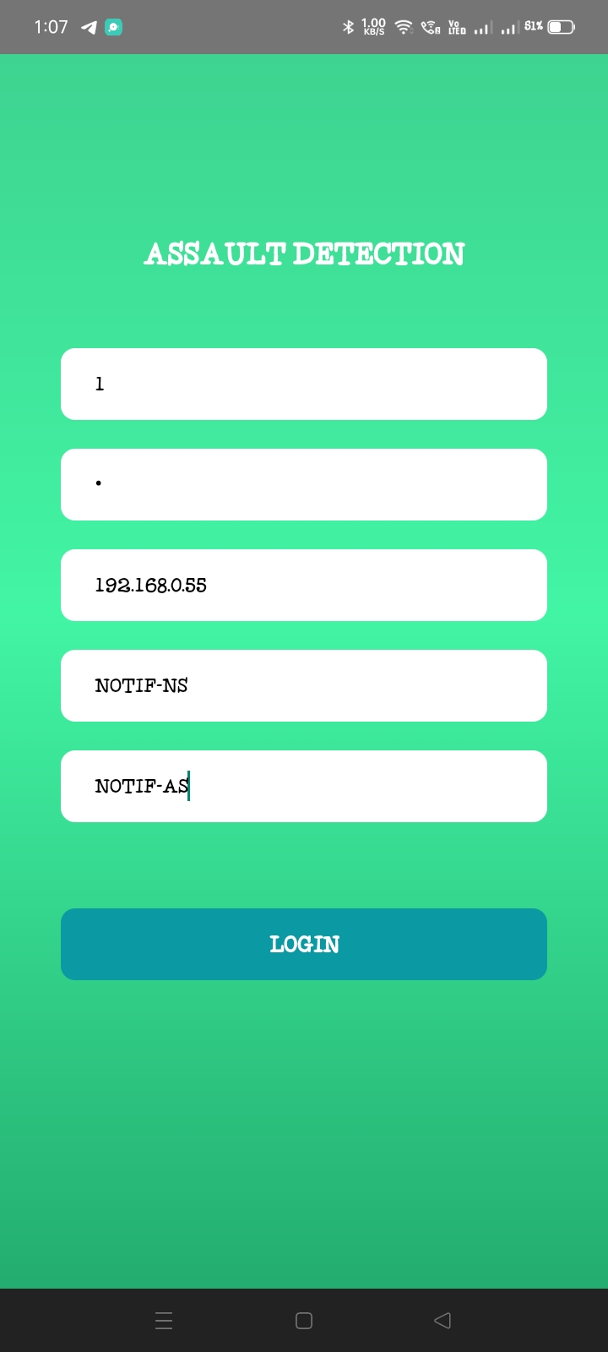
MOBILE APP HOME PAGE

Slide 47

PUBLIC ASSAULT DETECTION STATUS

Slide 48
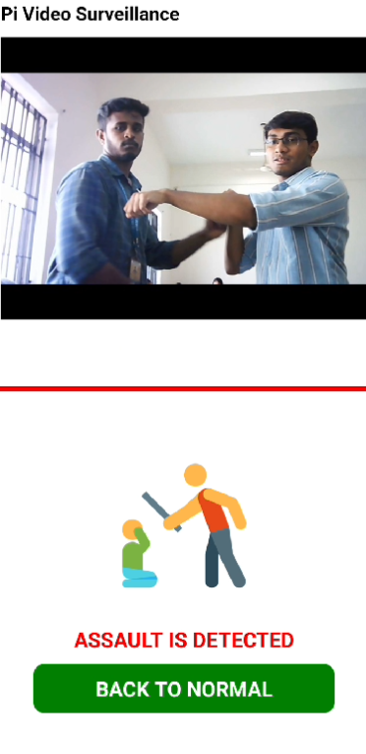
PUBLIC ASSAULT DETECTION LIVE STREAMING

Slide 49
WORK PLAN
Review | Work | Status
0th | Identifying area of work and problem statement Solution provided Various study regarding project | Completed
1st | 20-30% of project completion | Completed
2nd | 50-60% of project completion | Completed
3rd | Entire project completion | Completed

Slide 50
TIMELINE

Slide 51
REFERENCE
[1] A Deep Clustering via Automatic Feature Embedded Learning for Human Activity Recognition Ting Wang, Student Member, IEEE, Wing W. Y. Ng*, Senior Member, IEEE, Jinde Li, Qiuxia Wu, Member, IEEE, Shuai Zhang, Member, IEEE, Chris Nugent, Senior Member, IEEE, Colin Shewell, Member, IEEE[2021]
[2] PrivHome: Privacy-Preserving Authenticated Communication in Smart Home Environment, Geong Sen Poh, Prosanta Gope, Member, IEEE , and Jianting Ning [2019, VOL. 99, NO. 99]
[3] Continuous Human Motion Recognition With a Dynamic Range-Doppler Trajectory Method Based on FMCW Radar, Chuanwei Ding , Student Member, IEEE, Hong Hong , Member, IEEE, Yu Zou, Student Member, IEEE, Hui Chu , Xiaohua Zhu, Member, IEEE, Francesco Fioranelli , Member, IEEE, Julien Le Kernec , Senior Member, IEEE, and Changzhi Li , Senior Member, IEEE [2019, VOL. 57, NO. 9, ]

Slide 52
REFERENCE
[4] PRNU-Based Camera Attribution from Multiple Seam-Carved Images, BSamet Taspinar, Manoranjan Mohanty, and Nasir Memon.
[2017, VOL. 20, NO. 5, ]
[5] An Integrated Cloud-Based Smart Home Management System with Community Hierarchy, Ying-Tsung Lee, Wei-Hsuan Hsiao, Chin-Meng Huang and Seng-Cho T. Chou. [2016, Vol No: 2162-237X]
[6] Presentation Attack Detection for Face Recognition using Light Field Camera, R. Raghavendra Kiran B. Raja Christoph Busch Norwegian Biometric Laboratory, Gjøvik University College, Norway. [TIP.2015.2395951]

